Slide 1
Data Mining and Warehousing Concepts
Lecture 1

Slide 2
Data Warehousing Concepts & Characteristics

Slide 3
What is Data Warehouse??????
It is an emerging data repository architecture.
This is a repository of multiple heterogeneous data sources organized under a unified schema at a single site to facilitate management decision making.
“A data warehouse is a subject - oriented, integrated, time variant and non-volatile collection of data in support of management decision making process.”
These four keywords—subject-oriented, integrated, time-variant, and nonvolatile distinguish data warehouses from other data repository systems, such as relational database systems, transaction processing systems, and file systems.

Slide 4
Data Warehouse Properties
Subject
Oriented
Integrated
Data
Warehouse
Non Volatile
Time Variant

Slide 5
What is Data Warehouse??????
Subject-Oriented : Stored data according to target specific subjects.
Example : It may store data regarding total Sales, Number of Customers, etc. and not general data on everyday operations.
Integrated : Data may be distributed across heterogeneous sources which have to be integrated.
Example: Sales data may be on RDB, Customer information on Flat files, etc.
Time Variant : Data are stored to provide information from an historic perspective. Example: Data of sales in last 5 years, etc.
Non-Volatile : It is separate from the Enterprise Operational Database and hence is not subject to frequent modification. It generally has only 2 operations performed on it: Loading of data and Access of data.

Slide 6

Heterogeneous Information Sources
“Heterogeneities are everywhere”
Personal
Databases
World
Wide
Web
Scientific Databases
Digital Libraries
Different interfaces
Different data representations
Duplicate and inconsistent information

Slide 7
Features of a Warehouse…….
It is separate from Operational Database.
Integrates data from heterogeneous systems.
Stores HUGE amount of data, more historical than current data.
Does not require data to be highly accurate.
Queries are generally complex.
Goal is to execute statistical queries and provide results which can influence decision making in favor of the Enterprise.
These systems are thus called Online Analytical Processing Systems (OLAP).

Slide 8
Differences between Operational Database Systems and Data Warehouses
The major task of operational database systems is to perform online transaction and query processing. These systems are called Online Transaction Processing (OLTP) systems. It covers most of the day-to-day operations of an organization such as purchasing, inventory, manufacturing, banking, payroll, registration, and accounting.
Data warehouse systems, on the other hand, serve users or knowledge workers in the role of data analysis and decision making. These systems are known as online analytical processing (OLAP) systems.

Slide 9
 | Operational DB Systems | Data Warehouse Systems
Users | An OLTP system is customer-oriented and used by clerks, clients, and IT professionals. | An OLAP system is market-oriented and is used for data analysis by knowledge workers, including managers, executives, and analysts.
Data Contents | Current and detailed data and is subject to modifications. | Historical data generally not modified.
Database Design | Usually E-R model. (Application oriented Database Design) | Usually Multidimensional model (Star, Snowflake…). (Subject Oriented Database Design)
Access Pattern (Nature of Query) | OLTP systems mainly consist for Short and atomic transaction desiring high performance (less latency) and accuracy. It requires Concurrence Control and Recovery mechanisms. | Mostly read only queries, operate on HUGE volumes of data, queries are quite complex.
Database Size | In Gigabytes to higher order Gigabytes. | > = Terabytes or Petabytes.
View | Detailed | Summarized.

Slide 10
Need of a Separate Data Warehouse
OLTP systems require high Concurrency, Reliability, Locking which provide good performance for short and simple OLTP queries. An OLAP query is very complex and does not require these properties. Use of OLAP query on OLTP system degrades its performance.
OLAP systems access historical data and not current volatile data while OLTP systems access current up-to-date data and do not need historical data.
An operational database is designed for known tasks like indexing and hashing using primary keys, searching for particular records, and many more.
On the other hand, data warehouse queries are often complex. They involve the computation of large data groups at summarized levels, and may require the use of special data organization, access, and implementation methods based on multidimensional views.

Slide 11
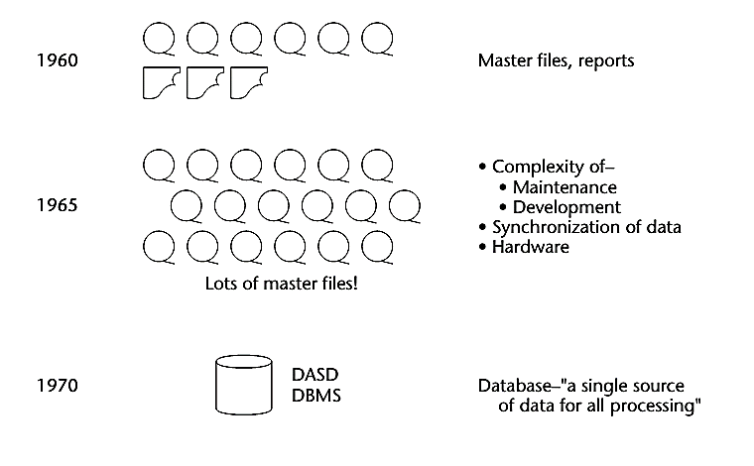
Origin/Evolution of Data Warehouse

Slide 12
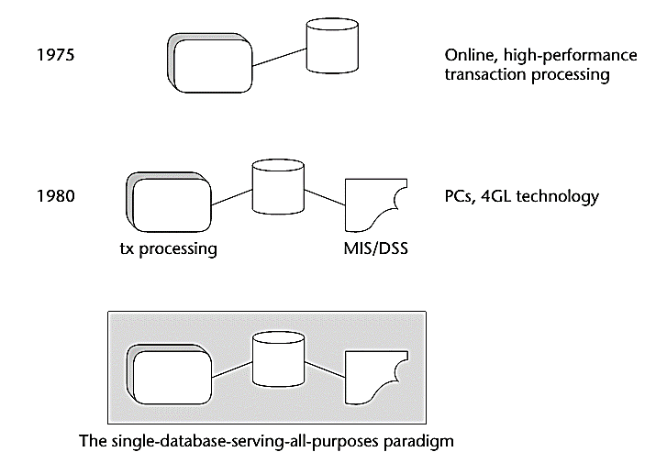

Slide 13
In the early 1960s, the world of computation consisted of creating individual applications that were run using master files, usually built in an early language such as Fortran or COBOL. The master files were housed on magnetic tape. The magnetic tapes were good for storing a large volume of data cheaply, but the drawback was that they had to be accessed sequentially.
Around the mid-1960s, the growth of master files and magnetic tape exploded. And with that growth came huge amounts of redundant data.
By 1970, the day of a new technology for the storage and access of data had dawned. The 1970s saw the advent of disk storage, or the direct access storage device (DASD). Disk storage was fundamentally different from magnetic tape storage in that data could be accessed directly on a DASD. There was no need to go through records 1, 2, 3, . . . N to get to record N + 1.
By the mid-1970s, online transaction processing (OLTP) made even faster access to data possible. The computer could now be used for tasks not previously possible, including driving reservations systems, bank teller systems, manufacturing control systems, and the like.
By the 1980s, more new technologies, such as PCs and fourth-generation languages (4GLs), began to surface.

Slide 14
Data Mining Concepts & Functionalities

Slide 15
What is Data Mining??????
It is also known as Knowledge Discovery from Data (KDD).
We live in a world where vast amounts of data are collected daily. Analyzing such data is an important need.
“We are living in the information age” is a popular saying; however, we are actually “living in the data age”.
This explosive growth of available data volume is a result of the computerization of our society and the fast development of powerful data collection and storage tools.

Slide 16
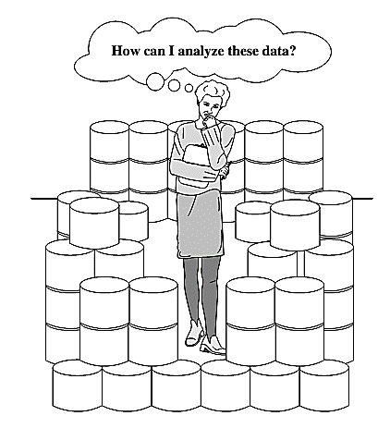
The world is data rich but information poor

Slide 17


Slide 18
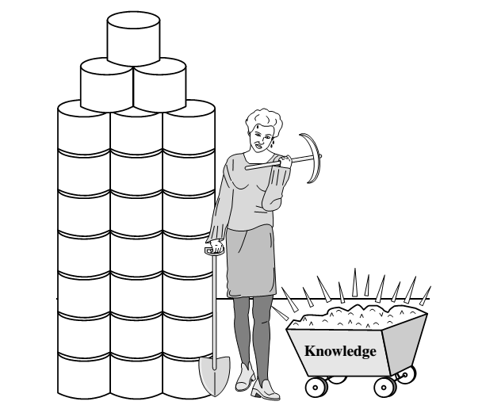
Data collected in large data repositories become “data tombs”. The data mining tools that can turn data tombs into “golden nuggets” of knowledge. Golden nuggets means “small but valuable facts”.
Data mining is also called as knowledge mining from data, knowledge extraction, data/pattern analysis, data archaeology, and data dredging.

Slide 19
The knowledge discovery process
It is an iterative sequence of the following steps:
Data cleaning (to remove noise and inconsistent data)
Data integration (where multiple data sources may be combined)
Data selection (where data relevant to the analysis task are retrieved from the database)
Data transformation (where data are transformed and consolidated into forms appropriate for mining by performing summary or aggregation operations)
Data mining (an essential process where intelligent methods are applied to extract data patterns)
Pattern evaluation (to identify the truly interesting patterns representing knowledge based on interestingness measures)
Knowledge presentation (where visualization and knowledge representation techniques are used to present mined knowledge to users)

Slide 20
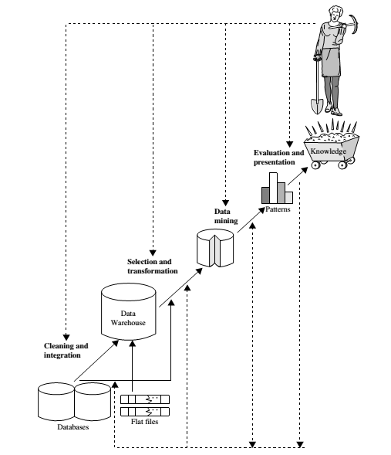

Slide 21
Data Mining Functionalities
Data mining functionalities are used to specify the kinds of patterns to be found in data mining tasks.
Class/Concept Description: Characterization and Discrimination:
Data entries can be associated with classes or concepts.
For example, in the AllElectronics store, classes of items for sale include computers and printers, and concepts of customers include bigSpenders and budgetSpenders. Such descriptions of a class or a concept are called class/concept descriptions.

Slide 22
Data characterization
It is a summarization of the general characteristics or features of a target class of data.
The data corresponding to the user-specified class are typically collected by a query.
For example, to study the characteristics of software products with sales that increased by 10% in the previous year, the data related to such products can be collected by executing an SQL query on the sales database.
There are several methods for effective data summarization or characterization. The data cube-based OLAP roll-up operation can be used to perform user-controlled data summarization along a specified dimension.
The output of data characterization can be presented in various forms. Examples include pie charts, bar charts, curves, multidimensional data cubes, and multidimensional tables, including crosstabs.

Slide 23
Data discrimination
Data discrimination is a comparison of the general features of the target class data objects against the general features of objects from one or multiple contrasting classes.
The target and contrasting classes can be specified by a user, and the corresponding data objects can be retrieved through database queries.
For example, a user may want to compare the general features of software products with sales that increased by 10% last year against those with sales that decreased by at least 30% during the same period.

Slide 24
Mining Frequent Patterns
Frequent patterns, as the name suggests, are patterns that occur frequently in data.
There are many kinds of frequent patterns, including item-sets, and subsequences.
A frequent item-set typically refers to a set of items that frequently appear together in a transactional data set, such as milk and bread, which are frequently bought together in grocery stores by many customers.
Mining frequent patterns leads to the discovery of interesting associations and correlations within data.

Slide 25

Association analysis
Where X is a variable representing a customer.
A confidence, or certainty, of 50% means that if a customer buys a computer, there is a 50% chance that he/she will buy software as well.
A 1% support means that 1% of all the transactions under analysis show that computer and software are purchased together.

Slide 26
Classification and Regression for Predictive Analysis
Classification is the process of finding a model (or function) that describes and distinguishes data classes or concepts.
Eg : male or female
The derived model is based on the analysis of a set of training data (i.e., data objects for which the class labels are known).
The model is used to predict the class label of objects for which the class label is unknown.
Regression analysis is a statistical methodology that is most often used for numeric prediction, although other methods exist as well.

Slide 27
“How is the derived model presented?”
The derived model may be represented in various forms, such as classification (IF-THEN) rules, decision trees, mathematical formulae, or neural networks

Slide 28
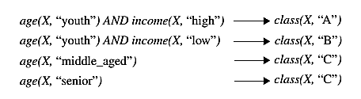
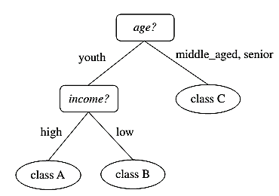
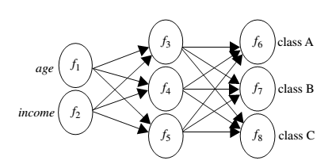
IF - THEN Rules
Decision Tree
Neural Net

Slide 29
Cluster analysis
Unlike classification and prediction, which analyze class-labeled data objects, clustering analyzes data objects without consulting a known class label.
In general, the class labels are not present in the training data simply because they are not known to begin with. Clustering can be used to generate such labels.
The objects are clustered or grouped based on the principle of
“maximizing the intra-class similarity and minimizing the interclass similarity”
That is, clusters of objects are formed so that objects within a cluster have high similarity in comparison to one another, but are rather dissimilar to objects in other clusters.

Slide 30
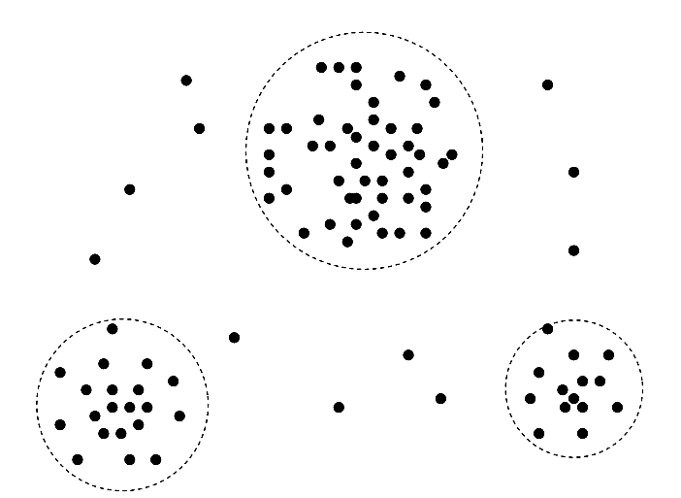

Slide 31
Outlier Analysis
Data objects that do not match with the general behavior or model of the data. Most analysis discard outliers as noise or exceptions.
Outliers may be detected using statistical tests, or using distance measures where objects that are a substantial distance from any other cluster are considered outliers.
Example: outlier analysis may uncover fraudulent usage of credit cards by detecting purchases of extremely large amounts for a given account number in comparison to regular charges incurred by the same account

Slide 32
Are All Patterns Interesting?
Only a small fraction of the patterns potentially generated would actually be of interest to any given user.
a pattern is interesting if it is:
easily understood by humans
valid on new or test data with some degree of certainty
potentially useful
Novel (New)

